Slide 1
AFAOC Data Analytics: Leveraging business intelligence for Air Force Accounting Operations
Mr. Josh Johnson
SAF/FMF AFAOC
20 APR 22

Slide 2
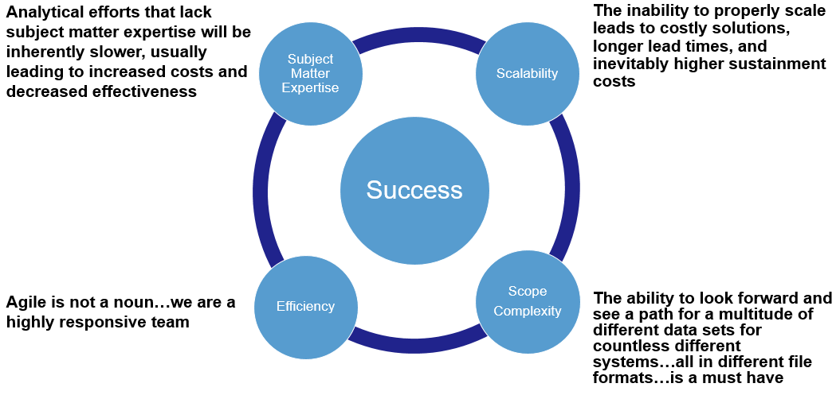
AFAOC Data & Analytics Team

Slide 3
What is Innovation?
Provides Value
Delivers a Solution
Original
How do you define innovation?
Is “new” enough to be innovative?
Is “creative” enough?
Is involving new technology enough?
My definition involves 3 tests to be innovative
Does it offer something new?
If it isn’t something new then it would be optimization or improvement
Innovation implies being novel
Does it deliver a solution to a relevant problem?
If not then is it more Art than innovation
Art is valuable but it doesn’t normally solve a problem
Does it provide value?
If not then it would be an invention
Inventions can lead to value but must be applied
Art
Optimize
Invention

Slide 4
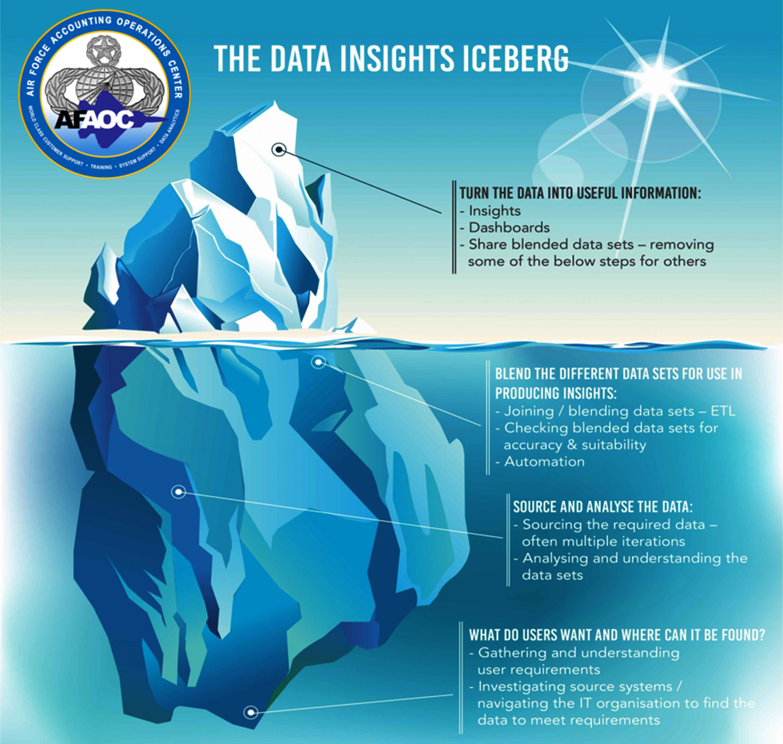
Iceberg Insights
The tip of the iceberg!
Often times the most used but also often the least amount of effort in the process
Benefits of seeing the same iceberg
Single source of truth
Quickly share, discuss, analyze, and act
Technology allows this to be done crossed oceans instead of over the shoulder
Under the water – out of sight/out of mind
Analysis begins with a need
Must identify the technologies available – what is the best option
What data is required – what format?
Do we have the technical skills?
Do we have the functional knowledge?
Don’t be afraid to start again!

Slide 5
Online Community Engagment
DEAMS Users Group
2x engagement
On-demand content from SMEs
Tracked and archived Q&As
milBook
Collaborate with partners across AFAFO/DFAS/MAJCOMs
Microsoft Teams
Virtual solution after sunset of DCS
No need for 3rd-party numbers or services (MeetMe, etc.)
Improved call quality/reliability

Slide 6
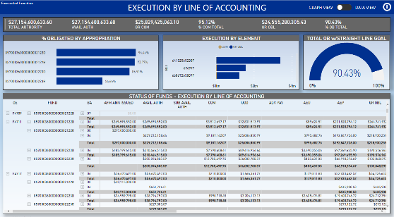
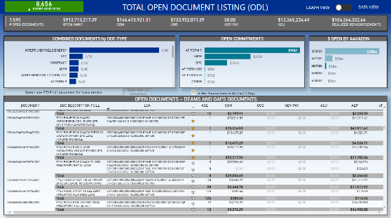
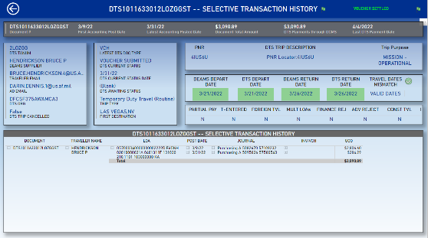
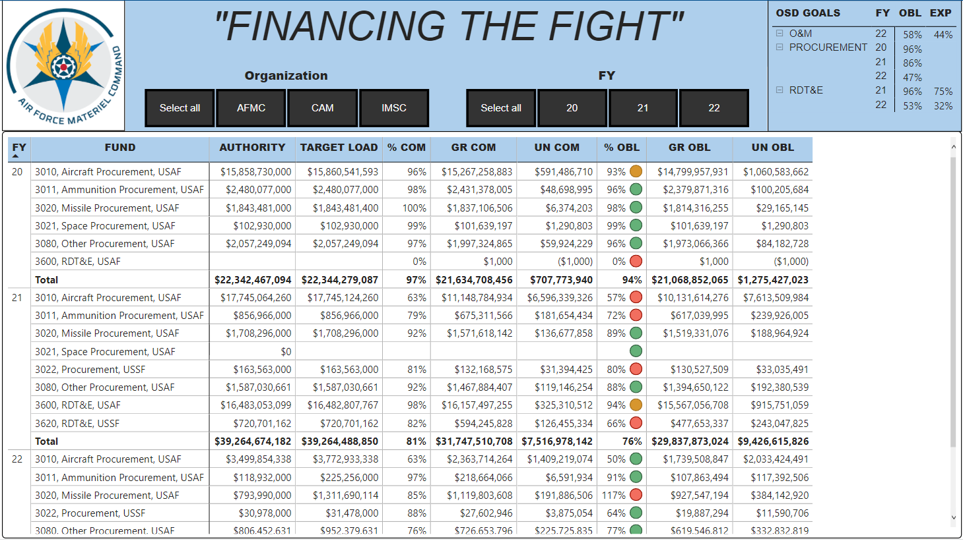
What Do We Do To Innovate?
User problems
Data availability
Data accuracy
Redundant local processes
Miscommunication through channels
Time is not infinite
Goals
Innovate
Save time, money, be valuable
Solution
Validated, accurate data
Cloud offering through Microsoft’s industry-leading PowerBI Service
Single source of truth
Scalable, flexible, brings silo’d systems together in new ways
Data Collect
Visualize
Extract
Transform
Model
Analyze
Share

Slide 7
What is PowerBI?
PowerBI
Microsoft provided business analytics solutions allowing access to over 100 data sources to ultimately visualize data in a unified, scalable platform for self-service business intelligence
Bridge the gap between data and decision making
Allow raw data from multiple unrelated sources to be compiled and processed through an end-to-end system for delivery
MUCH more than just a data visualization tool!
Extract Transform Load (ETL) platform
SSAS Tabular Model
In Memory Columnar Database (Vertipaq/xVelocity)
PowerBI does not refer to only our offerings…it is so much larger than AFAOC…we offer applications hosted in and developed using PowerBI!

Slide 8
What does AFAOC offer in the Cloud?
Hosted on Microsoft DOD GovCloud –
Impact Level (IL) 5 security IAW DOD SRG
FedRAMP High including NIST 800-53 – all data hosted in US
DEAMS and LEGACY STATUS OF FUNDS
DEAMS from GL Lines (NO MV issues)
DEAMS and GAFS OPEN DOCUMENT LISTING
DEAMS is accounting based (NO MV Issues)
GAFS is from DSR Refresh perspective
DEAMS and GAFS ODL Travel
DTS data details – DCMS TFO identifications
FM Morning Paper – DEAMS CTL information and more…
DEAMS Contracts
DEAMS MIPRS/MORDs

